Slide 1
Capstone Engagement Red vs. Blue
Assessment, Analysis, and Hardening of a Vulnerable System
Presentation by Reece Dillon - 2022/05/09

Slide 2
Table of Contents
This document contains the following sections:
01
Network Topology
02
Red Team: Security Assessment
03
Blue Team: Log Analysis and Attack Characterization
Hardening: Proposed Alarms and Mitigation Strategies
04

Slide 3
Network Topology
‹#›

Slide 4
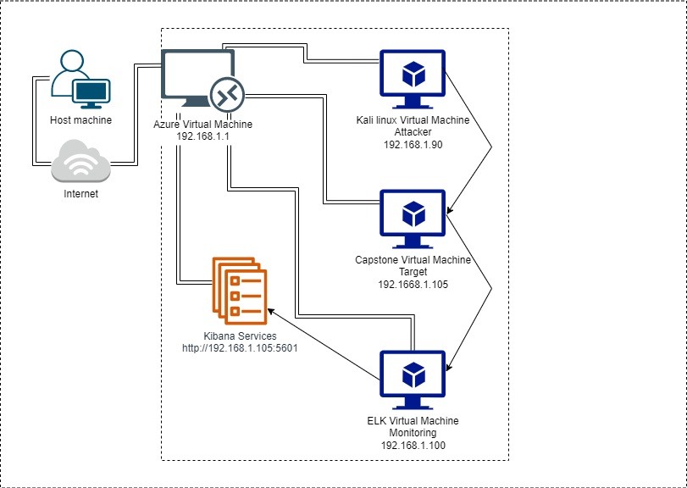
Network Topology
Network
Address Range: 192.168.1.0/24
Netmask: 255.255.255.0
Gateway: 192.168.1.1
Machines
IPv4: 192.168.1.1
OS: Windows 10 Pro
Hostname: Azure VM - Windows Gateway
IPv4: 192.168.1.90
OS: Linux
Hostname: Kali
IPv4: 192.168.1.100
OS: Linux
Hostname:ELK
IPv4: 192.168.1.105
OS: Linux
Hostname: Capstone

Slide 5

Red Team
Security Assessment
‹#›

Slide 6
Recon: Describing the Target
Nmap identified the following hosts on the network:
Hostname | IP Address | Role on Network
Azure Labs Virtual Machine - Red vs Blue | 192.168.1.1 | This is the gateway Windows VM which allows us access to the other 3 VMs hosted on Hyper-V Manager
Kali Virtual Machine | 192.188.1.90 | The Kali VM is the attacker machine used to pen-test against the vulnerable web server
Capstone Virtual Machine | 192.188.1.105 | The Capstone VM is the vulnerable apache web server being targeted running packetbeat, metricbeat and filebeat
ELK Virtual Machine | 192.188.1.100 | Network Monitoring VM to collect and process data from the attack to utilise in defence using Kibana

Slide 7
Vulnerability Assessment
The assessment uncovered the following critical vulnerabilities in the target:
Vulnerability | Description | Impact
Weak passwords/unsalted hashes | Passwords are short, some with no upper/lower case, special characters or numbers. Hashes are unsalted/additionally encrypted | Password can be cracked using John the Ripper, crackstation.net etc. or even guessed which can lead to their system being accessed
No password lockout policies for failed attempts to log in | No controls in place against continued attempts to access web server using different passwords | A brute force or wordlist attack like Hydra can be run against known users unabated
WebDAV vulnerability | Server is running WebDAV which allows remote users to modify information in the web server | The open facing port 80 and WebDAV can allow a Windows shell to exploit their server by uploading a payload using reverse_TCP

Slide 8
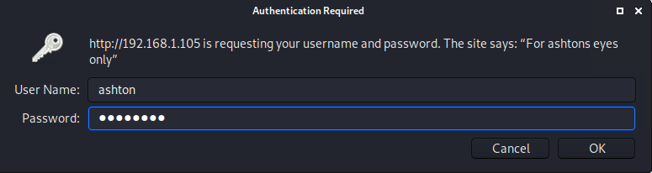
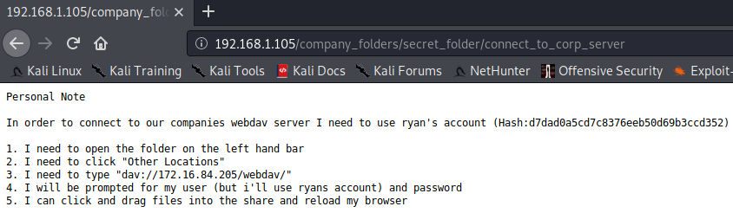
Exploitation: Weak passwords/unsalted hashes
We utilised the nmap command to enumerate the network and see the target IP showing port 80 is open on the Apache web server, then searching the website we found the user ashton and used the hydra wordlist to easily crack their password.
This allowed us unauthorised access to a folder with more instructions allowing us to penetrate deeper into their server and gain further information. In this instance we were given instructions on connecting to the webDAV server using Ryan’s credentials.

Slide 9
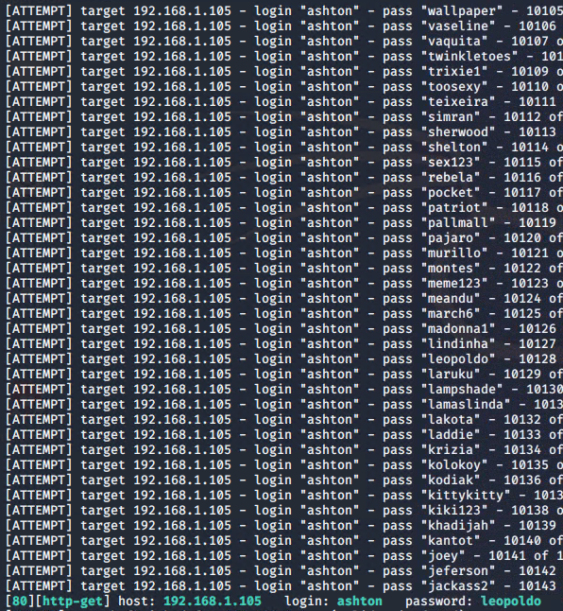
Exploitation: No failed login attempts policy
Using John the Ripper or Hydra, we could execute bruteforce attempts at cracking passwords without our attempts being stopped.
After 10143 attempts we were able to successfully solve the password and enter 192.168.1.105/company_folders/secret_folder using ashton’s password.
This allowed us to penetrate a layer deeper into their system and further our goal of exploiting their network to gain access to the flag.txt file.
The next layer gave us instructions on how to connect to the webDAV server and supplied Ryan’s hash which could be decrypted using crackstation.net.

Slide 10
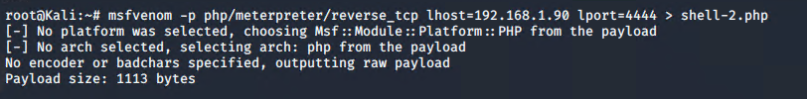
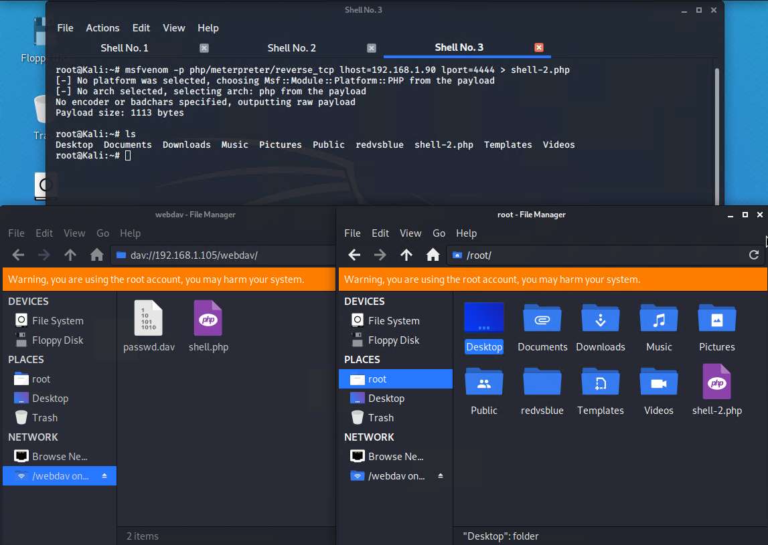
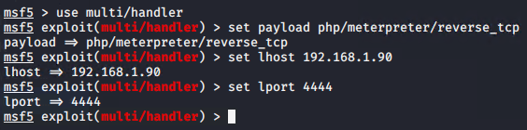
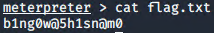
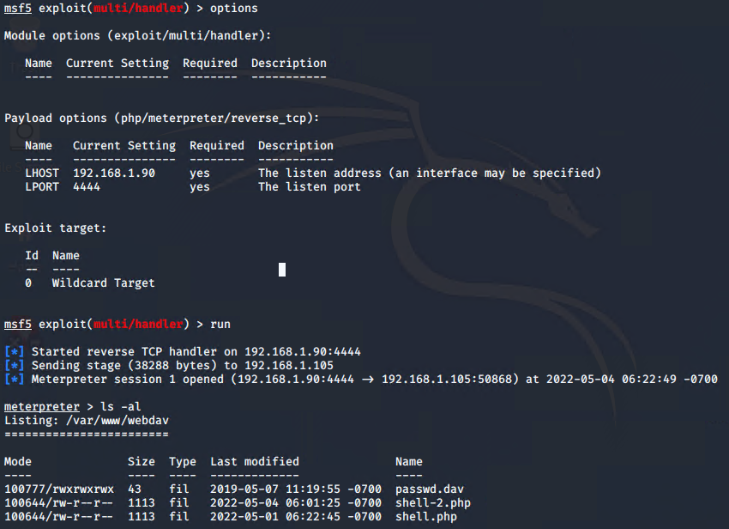
Exploitation: WebDAV vulnerability
After gaining access to the WebDAV server with port 80 open, we could then utilise a reverse_tcp connection to exploit the web server using msfvenomm and metasploit. We could then access the flag.txt file from metasploit.
We were able to transfer the exploit from the webdav directory to the webserver, triggering the reverse shell in the browser which was connected back to the meterpreter handler in metasploit.

Slide 11

Blue Team
Log Analysis and Attack Characterization
‹#›

Slide 12

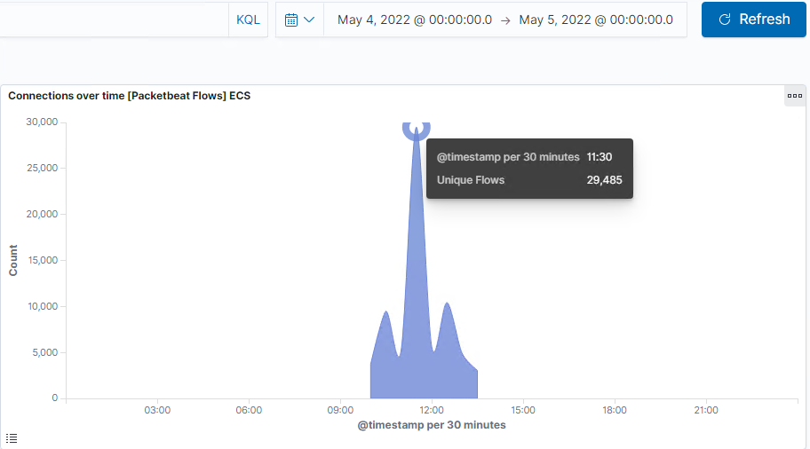
Analysis: Identifying the Port Scan
Timeframe of attack was 2022/5/4 10:00-13:30
29,485 packets were sent from 192.168.1.90 at 11:30.
The large volume of packets sent is indicative of a port scan.

Slide 13
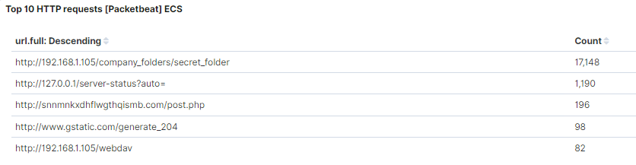
Analysis: Finding the Request for the Hidden Directory
17,148 requests were made at 2022/5/4 at 12:30.
The files for the secret folder which had access credentials for the WebDAV server and Ryan’s login hash were in the file.

Slide 14
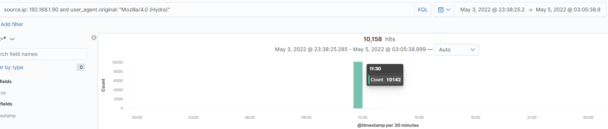
Analysis: Uncovering the Brute Force Attack
10,142 attempts were made before the attacker discovered the password.
This is also shown at the bottom of the image on the left in the hydra execution on the 10,143rd attempt being cracked.

Slide 15
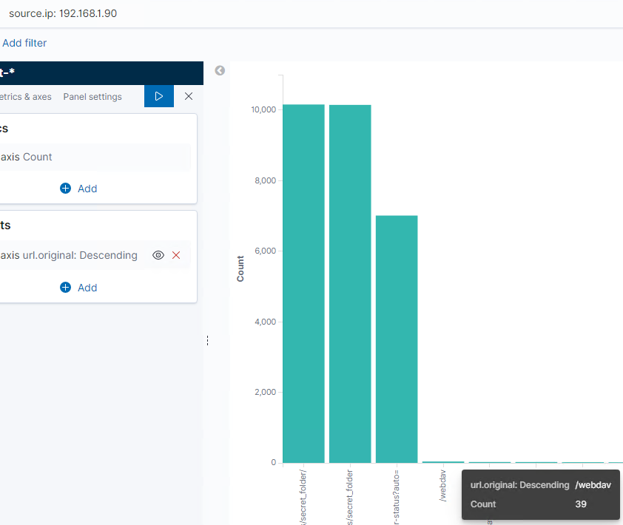
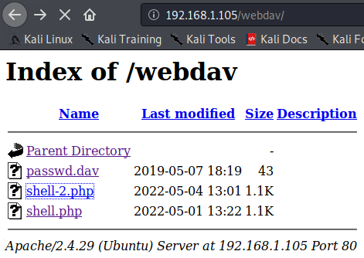
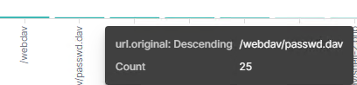
Analysis: Finding the WebDAV Connection
39 attempts were made to the /webdav directory.
The passwd.dav and shell and shell-2.php files were being requested.

Slide 16
Blue Team
Proposed Alarms and Mitigation Strategies
‹#›

Slide 17
Mitigation: Blocking the Port Scan
An alarm that notifies you of an influx of port scanning on the network that triggers once a threshold number has been reached would be integral.
Setting more than one alert rule for the alarm would be beneficial in capturing a larger range of types of attacks In this instance i would recommend 2 threshold levels;
10 or more attempts in 1 minute
200 or more attempts over 30 minutes
This would apply for any IPv4 over our network address range, 192.168.1.0/24.
I would recommend regularly scanning the network using Nmap and auditing the necessity of currently opened ports and closing ones that aren’t needed. In this case, port 4444.
For ports that need to be open, review or implement firewall policies, as well as patches that will obfuscate attempts to access them.
The use of an implementation of an IDS or TCP Wrapper, which will only allow specified hosts/domains to gain further information from the network, would also be beneficial from mitigating potential risk from an impending attack based off a port scan.

Slide 18
Mitigation: Finding the Request for the Hidden Directory
An alarm could be implemented to trigger alerts when the web servers hidden directories are attempted be accessed. This could be done by implementing a password lockout policy that implements after a threshold number of failed login attempts.
I would use Kibana to set this alert’s threshold level to 3 failed attempts over a 15 minute period to lock the account for 2-30 minutes. This would then send an e-mail or slack message to the SOC analyst for review of the IP address and attempt.
Configuring the firewall to whitelist authorised staff’s IPs only to be able to access the web server would be a useful deterrent for potential hackers attempting to gain access.
Strong passwords and password lockout policies could also be utilised to mitigate bruteforce attempts at gaining access to hidden directories.

Slide 19
Mitigation: Preventing Brute Force Attacks
An alarm should be set up in place to trigger an alert whenever a threshold number of failed login attempts is reached. As brute force attacks are typically high frequency over a short interval, I recommend a threshold level of;
5-10 attempts made over 1 minute.
The short frequency of 1 minute will alow defenders to more quickly respond to brute force attempts, however may flood alerts to SOC analysts when happening, so an alternate threshold may be more practical. E.g.;
500 attempts made every 15 minutes
A password lockout policy should be put in place to prevent continued attempts to gain access to the web server via brute force attacking. This would lock accounts automatically after a certain number of failed attempts. I would recommend 5 failed attempts over an hour would lock out that user for the same amount of time.
The user, if genuine, simply need to message the admin for access where the defenders can then analyse the data to investigate.
Strong password policies are also a must and a great way to make brute forcing much more ineffective.

Slide 20
Mitigation: Detecting the WebDAV Connection
Setting an alert in Kibana to recognise all attempts made from non whitelisted IP addresses to the WebDAV server, as well as critical alerts for unauthorized and Hydra variant attempts should be implemented.
An alert for any non whitelisted IP attempt sent every hour.
And any Hydra or unauthorized attempts set for every 15 minutes.
I would ensure that the firewall is configured for whitelisted IPs, add multi-factor authentication and configuring the /etc/hosts.allow file to restrict access and write privileges to authorised users only.

Slide 21
Mitigation: Identifying Reverse Shell Uploads
An alarm should be put in place for any http-put requests on port 80 or 4444, non whitelisted IPs, as well as whenever files are added or changed in the WebDAV folder.
Both alerts should be set to a threshold level of 1 instance every hour.
Closing port 4444, the addition of an IPS, and network segregation to minimise ease of traversing the network if compromised should be put in place. Analysing PCAPs can aid in identifying how far and to where in the network the attacker went.
Additionally, after any changed to the WebDAV folder are made, performing a “known-good” comparison, utilising a something such as the diff command in linux to ascertain if unauthorised parties have modified files to obfuscate the traces of their potential reverse shell payload.

